Slide 1
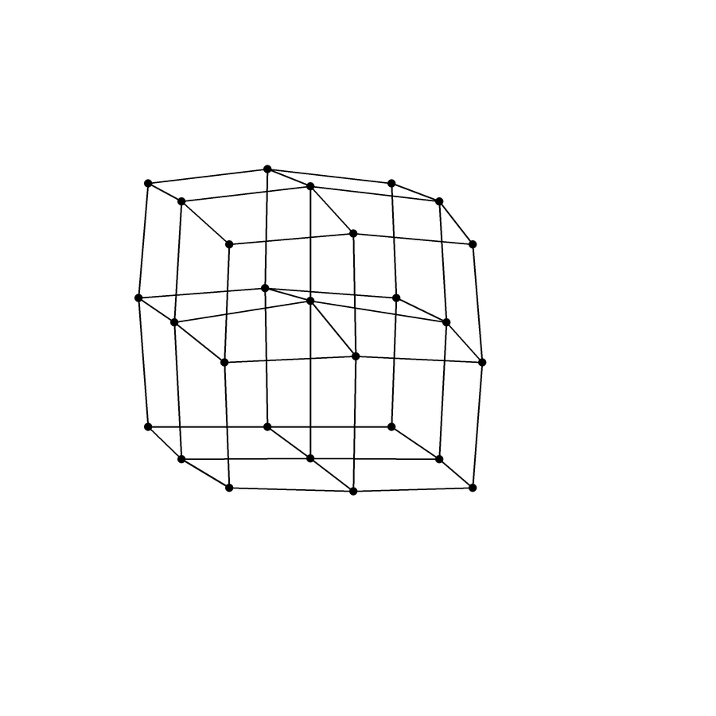
Inverse Physics for Soft Bodies
Question: How well can inverse physics recover soft-material latents vs simple feature models?
Shawn Nordstrom
Notes:
Studying inverse physics for soft bodies
Project question: how well can an inverse-physics model recover soft-material latents compared to a simple feature model?
Inverse physics: inferring hidden physical properties from observed motion
We wonder if the mind works in this way

Slide 2
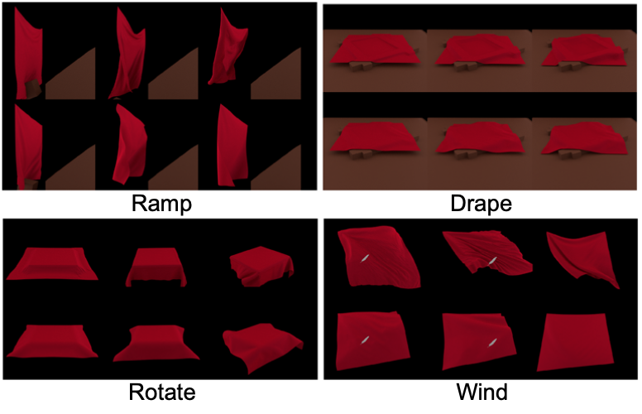
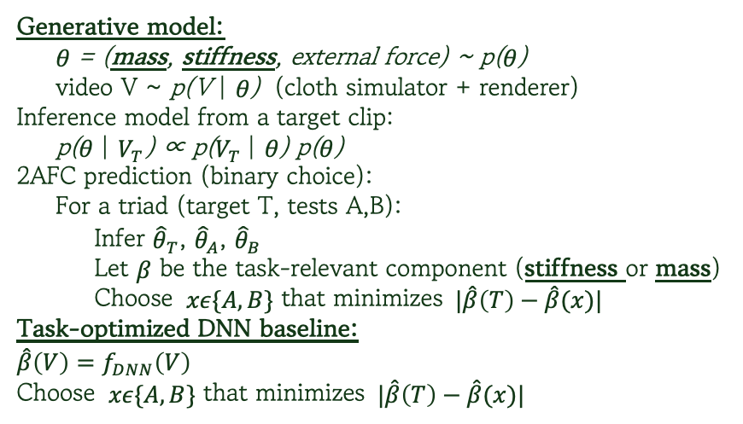
Prior work: Bi et al. cloth
Bi et al.: cloth simulator + inverse physics → human 2AFC “same material?” best fit by generative model
Generative model:
θ = (mass, stiffness, external force) ~ p(θ)
video V ~ p(V | θ) (cloth simulator + renderer)
Inference model from a target clip:
p(θ | $V_{T}$) ∝ p($V_{T}$| θ) p(θ)
2AFC prediction (binary choice):
For a triad (target T, tests A,B):
Infer ${\hat{θ}}_{T}$, ${\hat{θ}}_{A}$, ${\hat{θ}}_{B}$
Let $β$ be the task-relevant component (stiffness or mass)
Choose $xε\{A,B\}$ that minimizes $⁡|\hat{β}\left(T\right)−\hat{β}(x)|$
Task-optimized DNN baseline:
$$\hat{β}\left(V\right)=f_{DNN}\left(V\right)$$
Choose $xε\{A,B\}$ that minimizes $⁡|\hat{β}\left(T\right)−\hat{β}(x)|$
(Bi et al., 2025; doi:10.1038/s41467-025-61458-x)
Notes:
- Bi et al.L cloth simulator + inverse physics to model “same material?” judgments
Generative idea: choose physical parameters theta, run cloth sim → output video\
Inference: given a target video, infer theta that best explains it
2AFC: pick the test cip whose inferred theta is closest to the target’s
Compare to a DNN that maps video straight to an estimated stiffness/mass

Slide 3
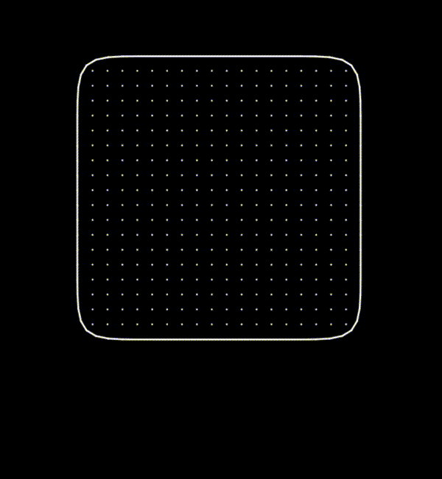

This project: generalized soft body object
Same $p\left(θ\right)p\left(video | θ\right)$ structure as Bi et al, but with a minimal soft-body world.
Taichi soft body physics model:
Mass spring grid:
The object is modeled as an nxn lattice of point masses, each connected to neighbors by springs. This approximates a deformable soft body affected by gravity, spring forces, and damping.
For drawing, take the outer ring of points and smooth the outline to form the visible shape.
Latent material parameters:
θ = (stiffness, damping)
By sweeping θ we generate a grid of impact videos with known ground-truth θ for model evaluation.
Notes:
I use a different world: a generalized soft body object in Taichi
nxn lattice of point masses connected by springs → deformable soft body
Latent material parameters: theta = (stiffness, damping)
By sweeping theta | generate many impact videos with known ground-truth theta
Same idea as Bi et al., but in a minimal, fully controlled world

Slide 4
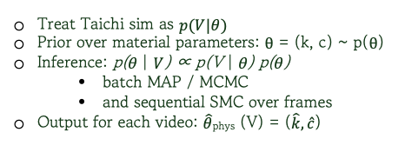
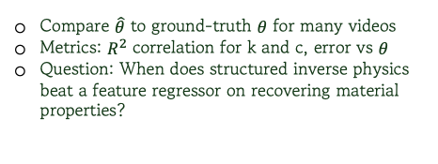
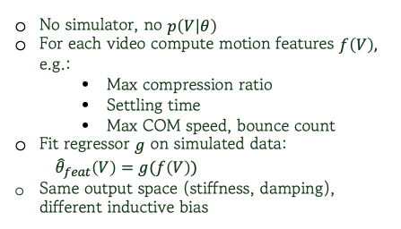
Two models on the soft-square world
Model 1: inverse-physics (generative)
Model 2: feature baseline (discriminative)
Evaluation
Model 1: Taichi + Gen
Model 2: feature model
Evaluation on simulated dataset
Treat Taichi sim as $p(V|θ)$
Prior over material parameters: $θ$ = (k, c) ~ p($θ$)
Inference: p(θ | $V$) ∝ p(V | θ) p(θ)
  batch MAP / MCMC
  and sequential SMC over frames
Output for each video: $\hat{θ}$_{phys} (V) = ($\hat{k},\hat{c}$)
No simulator, no $p\left(V | θ\right)$
For each video compute motion features $f\left(V\right),$ e.g.:
  Max compression ratio
  Settling time
  Max COM speed, bounce count
Fit regressor $g$ on simulated data:
${\hat{θ}}_{feat}\left(V\right)=g(f\left(V\right))$
Same output space (stiffness, damping), different inductive bias
Compare $\hat{θ}$ to ground-truth $θ$ for many videos
Metrics: $R^{2}$ correlation for k and c, error vs $θ$
Question: When does structured inverse physics beat a feature regressor on recovering material properties?
Notes:
Model 1: inverse physics
Prior on theta
Use Gen to infer p(theta | given) → get theta_phys
Also consider a sequential version that updates theta as frames arrives
Model 2:
No simulator; just compute motion features from each video
Learn a regression from features → theta_feat
Same outputs as Model 1, but no explicit physics model
Evaluation:
On simulated data, compare to ground truth
Look at R^2 errors to see when inverse physics beats the feature model

Slide 5
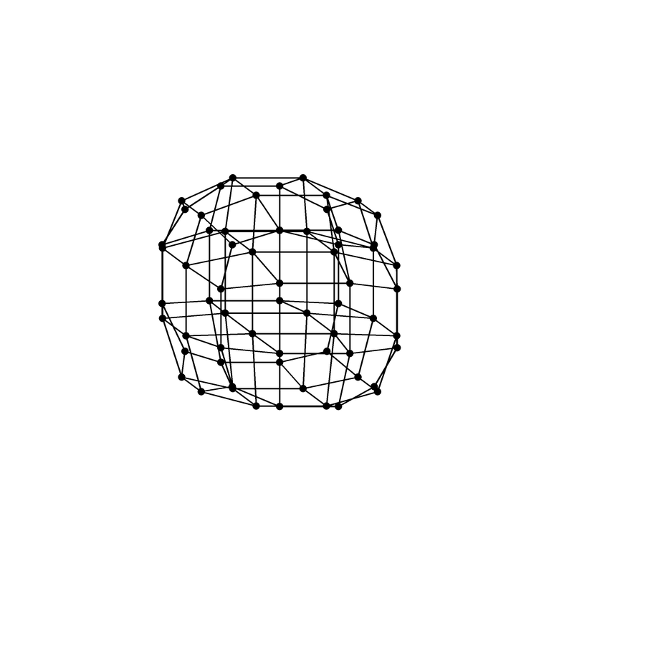
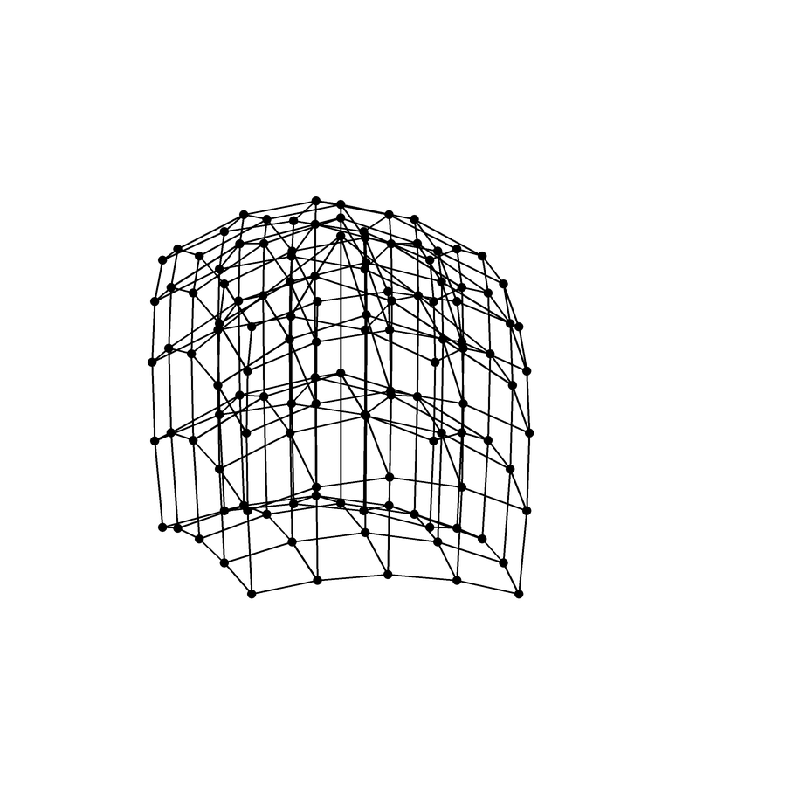
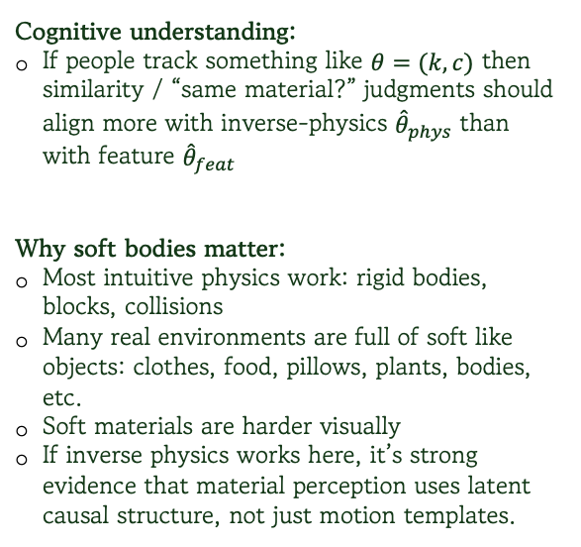
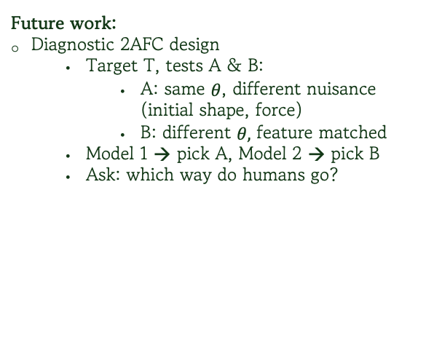
Minds & next steps
Cognitive understanding:
If people track something like $θ=(k,c)$ then similarity / “same material?” judgments should align more with inverse-physics ${\hat{θ}}_{phys}$ than with feature ${\hat{θ}}_{feat}$
Why soft bodies matter:
Most intuitive physics work: rigid bodies, blocks, collisions
Many real environments are full of soft like objects: clothes, food, pillows, plants, bodies, etc.
Soft materials are harder visually
If inverse physics works here, it’s strong evidence that material perception uses latent causal structure, not just motion templates.
Future work:
Diagnostic 2AFC design
  Target T, tests A & B:
    A: same $θ$, different nuisance (initial shape, force)
    B: different $θ,$ feature matched
  Model 1 → pick A, Model 2 → pick B
  Ask: which way do humans go?
Notes:
If people track something like stiffness and damping, their “same material?” choices should line up more with the inverse physics model than the feature model
Why soft bodies → most intuitive physics work is on rigid blocks, but real life is full of soft stuff
Soft bodies are visually messy → strong test of whether we use latent physics or just motion templates
Future work: 2AFC

Slide 6
Thank You!

